Slide 1
Lecture 4 Cluster Analysis
Faculty of Computer Science
Data Analysis
Moscow 2022
Lecturer: Alisa Melikyan, amelikyan@hse.ru, PhD,
Associate Professor of the School of Software Engineering

Slide 2
Cluster Analysis
Data Analysis
Lecture 4
Cluster Analysis
Cluster analysis is a way of grouping cases based on the similarity of their characteristics. It organizes observed data into meaningful groups, or clusters. Items in each cluster are similar in some ways to each other and dissimilar to those in other clusters.

Slide 3
Steps of cluster analysis
Data Analysis
Lecture 4
Cluster Analysis
1. Select a distance measure between clusters.
2. Select a clustering algorithm.
3. Determine the number of clusters.
4. Validate the analysis.

Slide 4
Distance measure
Data Analysis
Lecture 4
Cluster Analysis
The most straightforward and generally accepted way of computing distances between objects in a multi-dimensional space is to compute Euclidian distances (for continuous variables). There are other specialized measures for categorical variables.

Slide 5
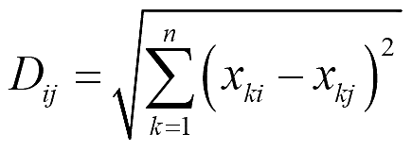
Euclidean Distance
Data Analysis
Lecture 4
Cluster Analysis
Euclidian distance is the geometric distance between two objects (or cases).
D_{ij} – distance between cases i and j
x_{ki} value of variable x_{k} for case i
Problems:
• Different measures = different weights
Solution: Standardization
• Correlation between variables (double counting)
Solution: Factor analysis before cluster analysis

Slide 6
Different clustering procedures
Data Analysis
Lecture 4
Cluster Analysis
Different procedures can be used to cluster data:
Hierarchical cluster analysis:
agglomerative (start from n clusters, to get to 1 cluster),
divisive (initially, all the points in the dataset belong to one cluster and split is performed recursively as we move down the hierarchy).
k-means cluster analysis.

Slide 7
Hierarchical cluster analysis
Data Analysis
Lecture 4
Cluster Analysis
Is recommended for a small data set if the purpose is to easily examine solutions with increasing numbers of clusters. First, each case is treated as an individual cluster. Clusters are then merged based on a criterion specific to the chosen method. So, we begin with as many clusters as there are cases and end up with just one cluster containing all cases. By inspecting the progression of cluster merging it is possible to isolate clusters of cases with high similarity.

Slide 8
Hierarchical cluster analysis
Data Analysis
Lecture 4
Cluster Analysis
To form clusters using a hierarchical cluster analysis, you must select:
A criterion for determining similarity or distance between cases;
A criterion for determining which clusters are merged at successive steps;
The number of clusters you need to represent your data.

Slide 9
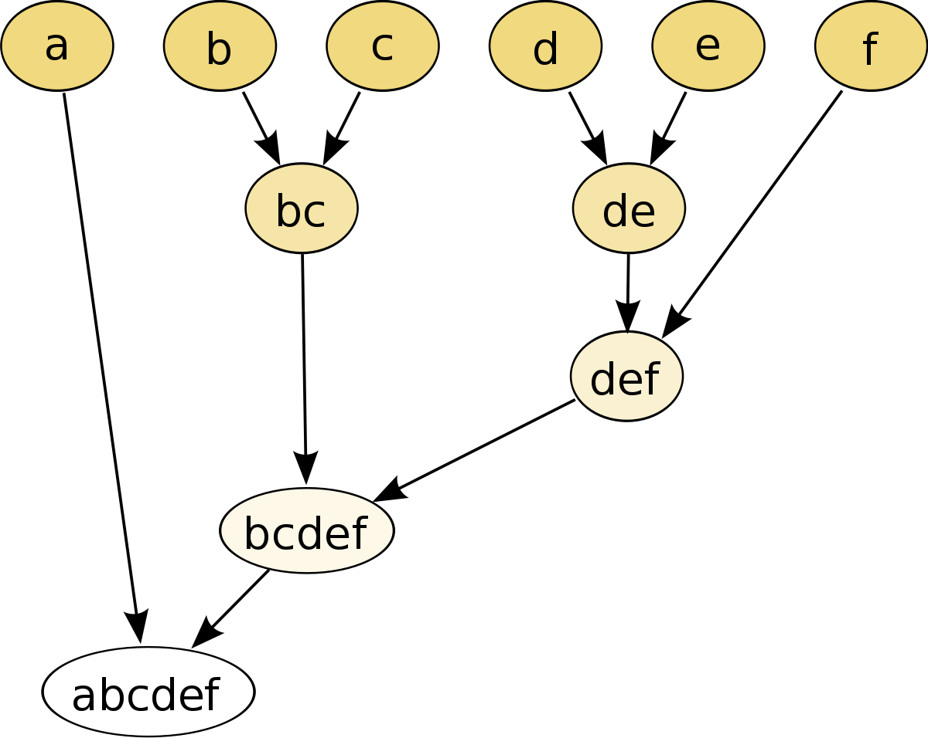
Data Analysis
Lecture 4
Cluster Analysis

Slide 10
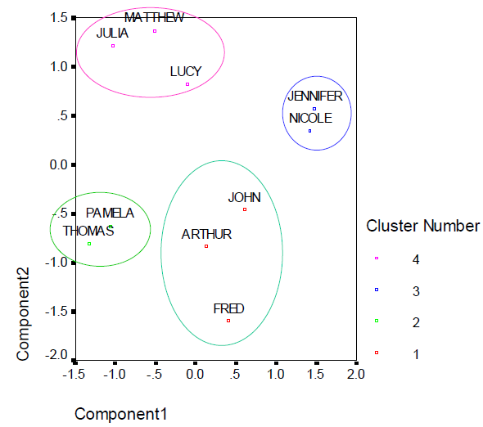
Data Analysis
Lecture 4
Cluster Analysis

Slide 11
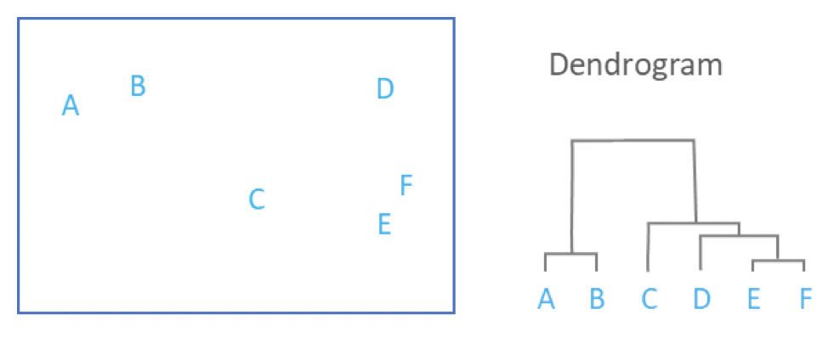
Data Analysis
Lecture 4
Cluster Analysis
Dendrogram shows the forks (or links) between cases and its structure gives us clues as to which cases form coherent clusters.

Slide 12
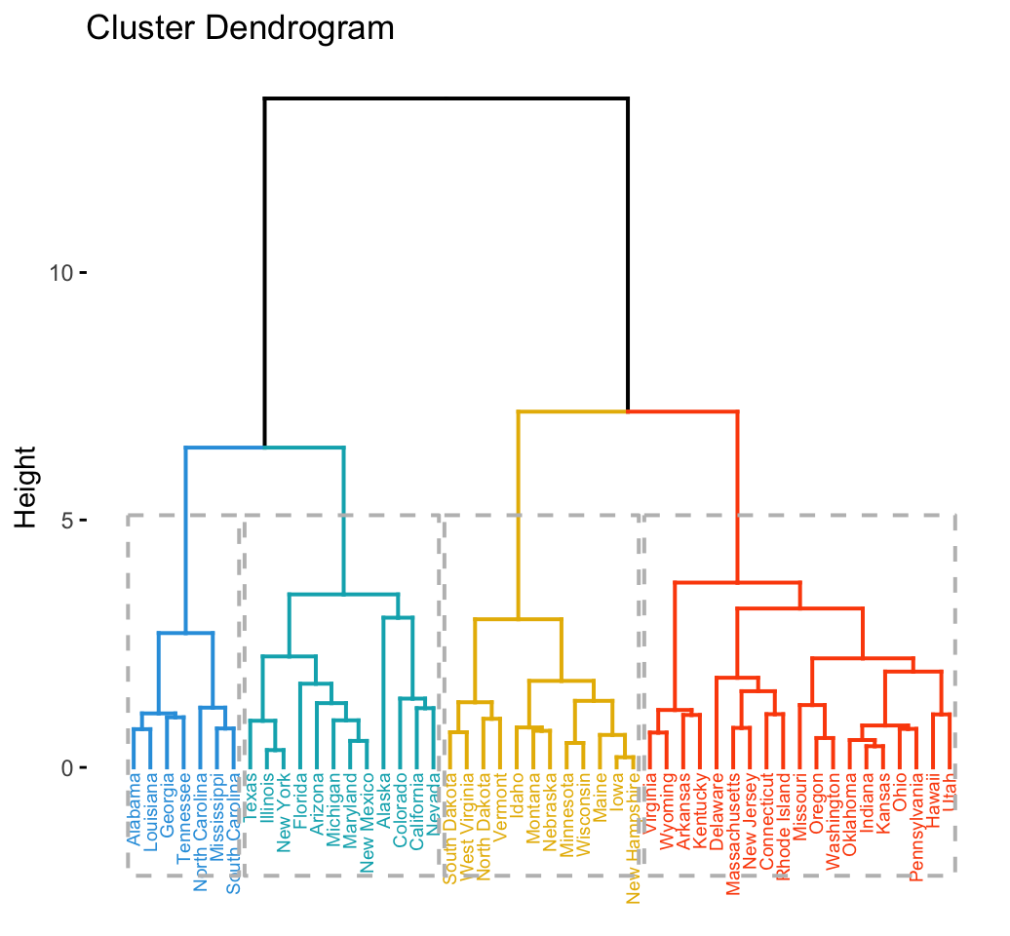
Data Analysis
Lecture 4
Cluster Analysis

Slide 13
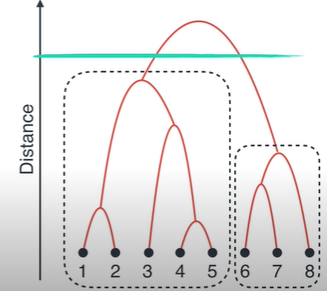
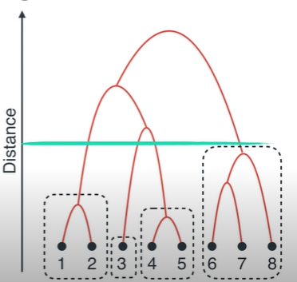
Data Analysis
Lecture 4
Cluster Analysis

Slide 14
Cluster Methods
Data Analysis
Lecture 4
Cluster Analysis
There are several procedures for combining clusters. The linkage methods are all based on similar principle: there is a chain of similarity leading to whether or not a case is added to a cluster. The rules governing this chain differ from one linkage method to another.

Slide 15
Cluster Methods
Data Analysis
Lecture 4
Cluster Analysis
Linkage methods
– Single linkage (minimum distance)
– Complete linkage (maximum distance)
– Average linkage (average distance)
Centroid method
– The distance between two clusters is defined as the difference between the centroids (cluster averages)
Ward’s method
1. Compute sum of squared distances within clusters
2. Aggregate clusters with the minimum increase in the overall sum of squares

Slide 16

Nearest neighbor / Single-linkage
Data Analysis
Lecture 4
Cluster Analysis
Defines the distance between the two clusters as the distance between closest elements in clusters. It will connect the clusters that are closest to each cluster.
Problem: can produce long chains. It’s less likely to get spherical clusters.

Slide 17

Furthest neighbor / Complete-linkage
Data Analysis
Lecture 4
Cluster Analysis
Defines the distance between the two clusters as the maximum distance over all possible pairs. It will merge the two clusters with the minimum resulting diameter.
It’s more likely to get spherical clusters with consistent diameter.

Slide 18
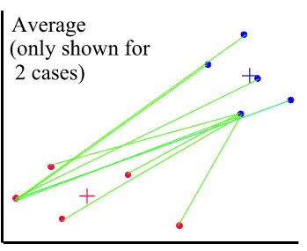
Average Linkage / Between Groups Linkage
Data Analysis
Lecture 4
Cluster Analysis
The distance between the two clusters is an average of all pairwise distances across the two clusters. The smallest average distance between all group pairs is computes and the two groups that are closest are combined. This approach is less affected by the outliers.

Slide 19

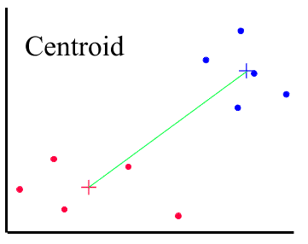
Centroid Clustering
Data Analysis
Lecture 4
Cluster Analysis
The centroids (means) of each cluster are calculated. It will merge the two clusters with the minimum distance between the centroids.

Slide 20

Ward’s Method
Data Analysis
Lecture 4
Cluster Analysis
It’s one of the best metrics and is widely used. It pretends to merge the two clusters based on the aggregate deviation of the result. If we want to merge two clusters, we estimate the centroid of the resulting cluster and then look for the sum of the squared deviations of all the points from the new centroid. For different merging pairs of clusters we will get different deviations. And we pick the merge that results in the smallest deviation.

Slide 21
k-means cluster analysis
Data Analysis
Lecture 4
Cluster Analysis
Is recommended for a moderately sized data set if the number of clusters is known beforehand. The algorithm iteratively estimates the cluster means and assigns each case to the cluster for which its distance to the cluster mean is the smallest.
It is used when the researcher already has hypotheses concerning the number of clusters in the analyzed cases. Very often hierarchical cluster analysis is performed first on a small sample to determine the number of clusters and then the k-mean cluster analysis is used to classify all the cases.

Slide 22
k-means cluster analysis: step 1
Data Analysis
Lecture 4
Cluster Analysis
Select the number of clusters you want to identify in the data. Your decision could be based on:
your research task,
results of other studies on a similar topic,
preliminary hierarchical cluster analysis based on small subsamples taken from the sample.

Slide 23
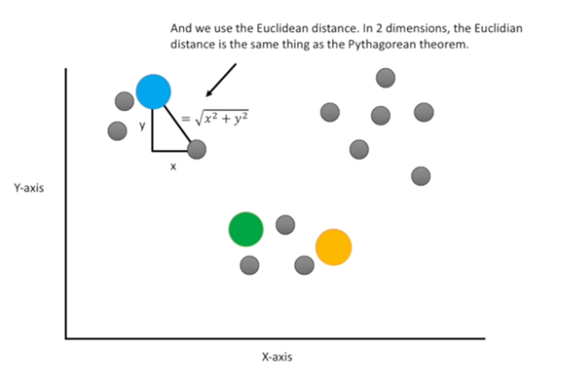
k-means cluster analysis: step 2
Data Analysis
Lecture 4
Cluster Analysis
Pick the random points according to the number of clusters that was selected at the previous step.

Slide 24
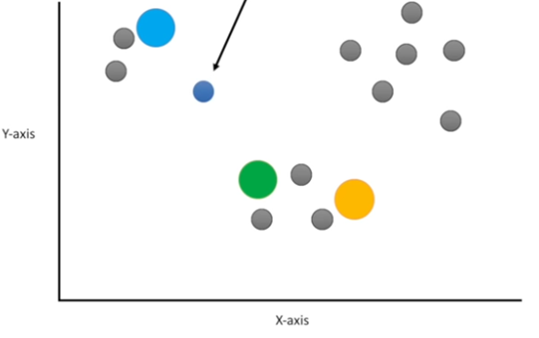
k-means cluster analysis: step 3
Data Analysis
Lecture 4
Cluster Analysis
Assign the points to the nearest clusters.

Slide 25
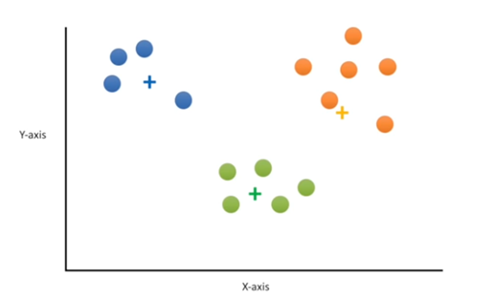
k-means cluster analysis: step 4
Data Analysis
Lecture 4
Cluster Analysis
Calculate the center of each cluster and recluster. Reclustering should be repeated until no improvements are possible.

Slide 26
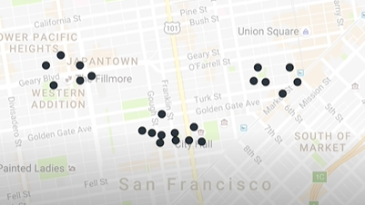
k-means clustering
Data Analysis
Lecture 4
Cluster Analysis
We want to select the best positions for three cafes.

Slide 27
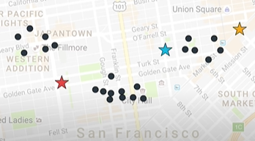
k-means clustering
Data Analysis
Lecture 4
Cluster Analysis
First, we locate three random points.

Slide 28
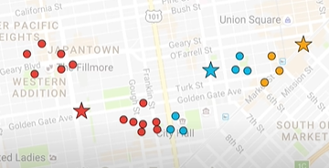
k-means clustering
Data Analysis
Lecture 4
Cluster Analysis
Second, we connect the points to the closest center.

Slide 29
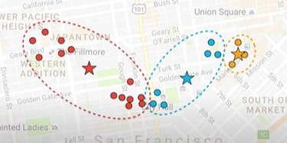
k-means clustering
Data Analysis
Lecture 4
Cluster Analysis
Third, we put the central points to the center of the houses that they are serving.

Slide 30
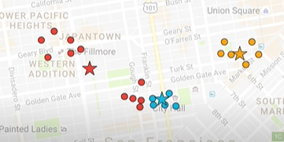
k-means clustering
Data Analysis
Lecture 4
Cluster Analysis
Forth, we recalculate the results to minimize the distance between each building and cafes that we have. And then we again recalculate the centers.

Slide 31
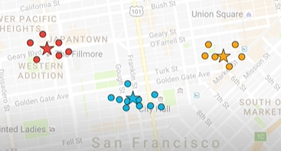
k-means clustering
Data Analysis
Lecture 4
Cluster Analysis
Final result.
Source: https://www.youtube.com/watch?v=QXOkPvFM6NU

Slide 32
Validating the results
Data Analysis
Lecture 4
Cluster Analysis
To validate the results we can use ANOVA test to check that the mean values of the variables are significantly different by clusters.
We can assess the quality of the clustering by calculating the variation of variables’ values within each cluster.

Slide 33
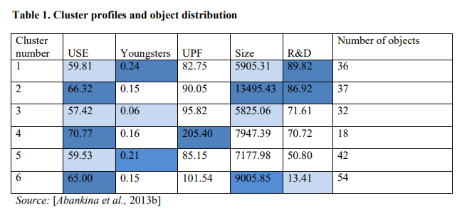
Cluster profiles
Data Analysis
Lecture 4
Cluster Analysis

Slide 34
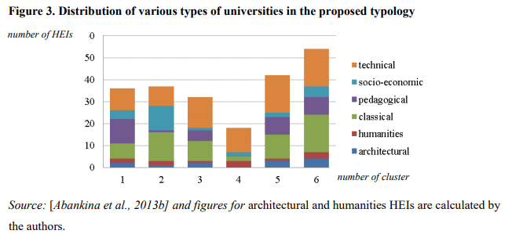
Comparing clusters
Data Analysis
Lecture 4
Cluster Analysis

Slide 35

Optimal number of clusters
Data Analysis
Lecture 4
Cluster Analysis
Calinski and Harabasz Index (CH Index) is often used for choosing the optimal number of clusters. This criterion combines the within and between cluster variance to evaluate the quality of segmentation. The formula of CH Index defined as:
where W is within-cluster variation, B is between-cluster variation, K is number of clusters, n is sample size. To obtain a small within-cluster variation and large between-cluster variation simultaneously, we would pick the value of K with the largest CH score as the stopping point.

Slide 36
Thank you for your attention!
Faculty of Computer Science
Data Analysis
Moscow 2022

